Slide 1
Genesis Quiz The Third
June 25

Slide 2
When the “stolen” cup is found in Benjamin’s sack of grain, which brother offers to be a slave in Benjamin’s place?
Judah (Gen. 44:16-34)

Slide 3
Who predicted that Noah would provide comfort to the people?
His father, Lamech (Gen. 5:28-29)

Slide 4
Who was Issachar’s mother?
Leah (Gen. 35:23)

Slide 5
People began TO “CALL UPON THE NAME OF THE Lord” when this antediluvian son was born.
Enos, Seth’s son (Gen. 4:26)

Slide 6
What was Rachel’s Maid’s name?
Bilhah (Gen. 30:1-4)

Slide 7
How many children did Adam have?
At least seven. We know about Cain, Abel, and Seth. But he also had “sons and daughters.” Note the plural! (Gen. 4:1-2, 5:3-4)

Slide 8
What was the second bird that Noah sent from the ark?
A DOVE. (Gen. 8:8)

Slide 9
Isaac lied to what king by identifying Rebekah as his sister?
Abimelech (Gen. 26:6-11)

Slide 10
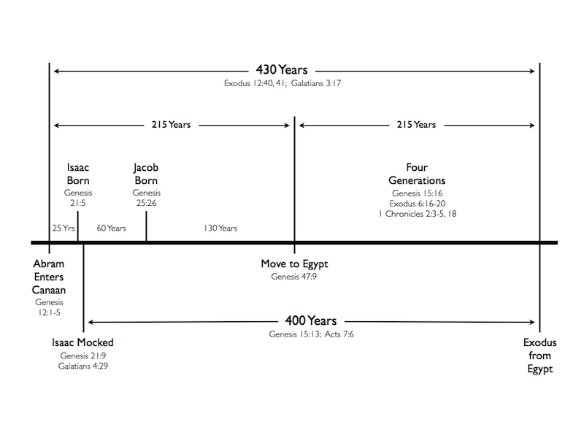
How many years elapsed between the Israelites’ entry into Egypt and the Exodus?
215 YEARS
(Gen. 15:13, Ex. 12:41, Gal. 3:17)

Slide 11
When Jacob moved his family to Egypt, How many of his descendants moved with him?
66 (Gen. 46:26)

Slide 12
How long DID Jacob serve with Laban?
20 Years (Gen. 31:41)

Slide 13
What was the very first command given to man?
“Be fruitful, and multiply…” (Gen 1:27-28)

Slide 14
Whose idea was it to throw Joseph into a pit rather than kill him?
Rueben suggested this, because he wanted to return Joseph to their father. (Gen. 37:21-22)

Slide 15
What did God originally give to man for food?
Every “herb bearing seed” and “every tree in the which is the gruit of a tree yielding seed” on the face of the earth. (Gen 1:29)

Slide 16
Who was Asher’s mother?
Zilpah, Leah’s handmaid (Gen. 35:26)

Slide 17
Who was keturah?
Abraham’s second wife (Gen 25:1)

Slide 18
Who was Simeon’s mother?
Leah (Gen. 35:23)

Slide 19
Joseph tells his Brothers that who sent him into Egypt?
God (Gen 45:5)

Slide 20
How long did Seth live?
YEARS (Gen. 5:8)

Slide 21
For what purpose does Joseph say that God sent him into Egypt?
To preserve life. (Gen 45:5)

Slide 22
Who was Joseph’s eldest son?
Manasseh (Gen. 41:51)

Slide 23
How old was Jacob when he met Pharaoh?
130 years (Gen 47:9)

Slide 24
Who was Gad’s mother?
Zilpah, Leah’s handmaid (Gen. 35:26)

Slide 25
How do the Egyptians survive the famine under Joseph’s hand?
They first pay for grain with money, then with cattle, then with their lands. (Gen 47:14-20)

Slide 26
The first bird that Noah sent forth was what?
A RAVEN (Gen. 8:7)

Slide 27
Almost all the land in Egypt came to be held by Pharaoh through the famine. What was the exception?
The land of the priests. (Gen 47:22)

Slide 28
What group of people originated with Lot’s Eldest daughter?
The Moabites (Gen. 19:37)

Slide 29
After Pharaoh came to own the land, how did the people survive?
Pharaoh took one-fifth of the increase from the land, but the people used the rest. (Gen 47:24)

Slide 30
How were Isaac and Rebekah related?
They were first cousins. Rebekah was the daughter of Nahor, Abraham’s brother. (Gen. 24:15)

Slide 31
Who was Seth’s son?
Enos (Gen. 5:6)

Slide 32
How old was Joseph when he became the second ruler of Egypt?
30 YEARS OLD (Gen. 41:46)

Slide 33
Who was Joseph’s second son?
Ephraim (Gen. 41:52)

Slide 34
Did the raven that Noah sent from the ark come back?
Not exactly. It “went forth to and fro, until the waters were dried up from off the earth.” (Gen. 8:7)

Slide 35
Terah, Abram’s father, died in what city on the way to canaan?
HARAN (Gen. 11:32)

Slide 36
Of what did Joseph accuse his brothers when they came to buy grain from Egypt?
Of being spies. (Gen. 42:9)

Slide 37
How long was Noah’s family on the ark in total?
One year and seventeen days. (Gen. 7:6-11; 8:13-14)

Slide 38
What group of people originated with Lot’s Younger daughter?
The Ammonites (Gen. 19:38)

Slide 39
Melchizedek was king of where?
SALEM (Gen. 14:18)

Slide 40
Which of Joseph’s sons was to be the greater?
Ephraim, the second born (Gen 48:17-20)

Slide 41
Who did Pharaoh give Joseph as his wife?
Asenath, the daughter of Potipherah priest of On. (One of the highest families in the land.) (Gen. 41:45)

Slide 42
Who was Dan’s mother?
Bilhah, Rachel’s handmaid (Gen. 35:25)

Slide 43
Which two men lived so long that, together, they span the entire time from creation to the flood?
Adam and Methuselah. Adam lived to be 930, overlapping Methuselah’s life by 244 years. Methuselah died in the same year that the Flood began. (Gen. 5:3-29 )

Slide 44
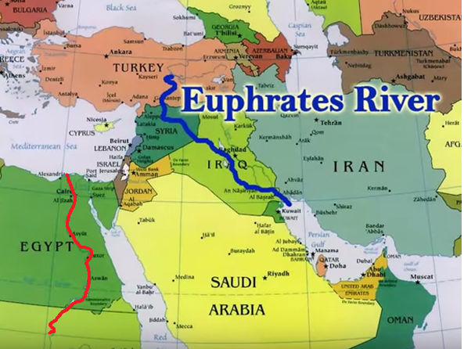
How much land did God promise to Abraham? (What were the bounds of it?)
Everything from the Nile River to the Euphrates River. (Gen. 15:18)

Slide 45
How does Joseph treat his brothers when they come to Egypt to buy grain?
He throws them in jail for three days, then says that one of them must remain while the others go to fetch Benjamin. (Gen. 42:17-20)

Slide 46
Who was Levi’s mother?
Leah (Gen. 35:23)

Slide 47
How long did Sarah Abraham’s wife live?
127 YEARS (Gen. 23:1)

Slide 48
The second time that Noah sent the dove, what did it bring back?
An olive leaf (Gen. 8:11)

Slide 49
What was Leah’s Maid’s name?
Zilpah (Gen. 30:9)

Slide 50
Who was Naphtali’s mother?
Bilhah, Rachel’s handmaid (Gen. 35:25)

Slide 51
How many years of famine were yet to go when Joseph invited his father to move to Egypt?
Five years. (Gen. 45:6)

Slide 52
What did Rachel name her second son? (Before it was changed by his father.)
Benoni (Gen. 35:18)

Slide 53
How long did Jacob live?
147 years (Gen 47:28)

Slide 54
How much money did Joseph’s brothers get from selling him?
Twenty pieces of silver (Gen. 37:28)

Slide 55
Which brother is left as a hostage in Joseph’s care?
Simeon (Gen. 42:24)

Slide 56
What punishment did Judah intend to inflict on Tamar, his daughter-in-law, when she was found to be pregnant without a husband?
He said “let her be burnt.” (Gen. 38:24)

Slide 57
How much time passed between Joseph’s interpretation of the Baker’s dream and its fulfillment?
Three days. (Gen. 40:1-3)

Slide 58
What special occasion was involved in the resolution of the Butler’s and Baker’s cases?
It was Pharaoh’s birthday. At the feast the sentences were carried out.
(Gen. 40:20)

Slide 59
Who was Zebulun’s mother?
Leah (Gen. 35:23)

Slide 60
What name did Pharaoh give Joseph?
Zaphnathpaaneah (Gen. 41:45)
]\=

